Slide 1
Subgroup analysis of: Ability, Gender and Performance Standards Lindo, Sanders, and Oreopoulos.
Frank Cousin
Educ 737
University of Michigan April 18, 2016

Slide 2
Research Question
How do low performing high school students’ respond to a negative signal (letter) and negative incentive(suspension) in college?
College remediation (negative)
Jacob and Lefgren (2004)
Martorell and McFarlin (2007)
High school exit exams (negative), Financial incentives for high school performance (positive)
Papay, Murnane, Willett (2008)
Fryer (2007)
Notes:
/threat of punishment

Slide 3

Setting of the Study
Three campuses
Campus one: central campus, 55% acceptance
Resembles large US state college
Probation cutoff 1.5 GPA
51% of sample at .6 bw
Satellite campuses, more part time and commuter students, 77% acceptance
Campus two: Probation cutoff 1.5 GPA, 20% of sample at .6 bw
Campus three: Probation cutoff 1.6 GPA, 29% of sample at .6 bw
Canada!

Slide 4
Who is included in the sample?
8 cohorts observed for two years entering 1996 to 2004
Ages 17 to 21
Have had their academic standing evaluated, and are within .6 GPA of cutoff
Students were omitted if they were missing any variable of interest
n= 12530

Slide 5
Procedures
RD local randomization: assumption that students within .6 GPA above and below cutoff are comparable
Treatment group: Students within .6 below cutoff were placed on academic probation
Letter telling them they are on probation and will be suspended if GPA in subsequent sessions is not above cutoff
Control: students just above the cutoff do not receive a letter or threat of suspension
Assumption that first-year students are less knowledgeable about the cutoff, therefore probation status near cutoff will be somewhat random on either side of the cutoff
Notes:
This assumption may be important later!!

Slide 6
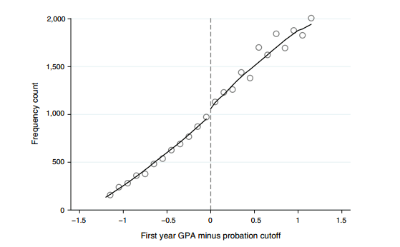

Slide 7
Measures
Outcome variables
Leaving after first year
Changes in GPA of subsequent semesters
Graduation in 4, 5, and 6 years
Independent variables
GPA distance from cutoff, discrete at the hundredth
Interactions on either side of cut, dummy interactions with distance
Covariates
Female/male
English native language/non
High school grades above/below median
Campus attending

Slide 8
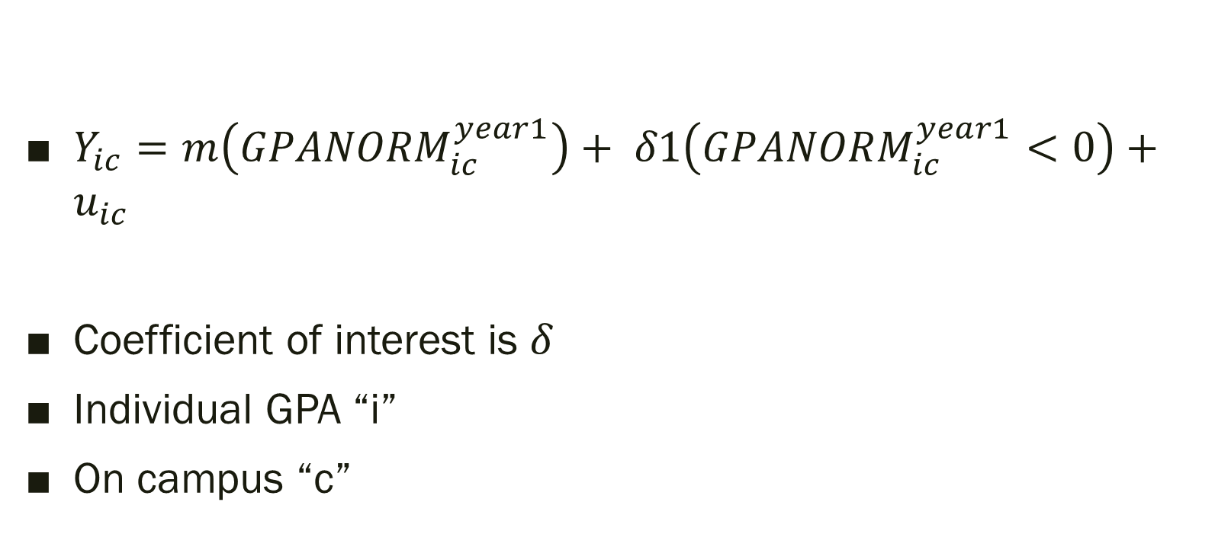
Equations
$Y_{ic}=m\left({GPANORM}_{ic}^{year1}\right)+ δ1\left({GPANORM}_{ic}^{year1}<0\right)+u_{ic}$
Coefficient of interest is $δ$
Individual GPA “i”
On campus “c”

Slide 9
Results
Leave after first evaluation
 | (1) | (2) | (3) | (4) | (5) | (6) | (7)
VARIABLES | all | lowHS | highHS | male | female | english | noenglish
Gpa<cutoff | 0.018* | 0.013 | 0.032~ | 0.037* | 0.006 | 0.028** | -0.004
 | (0.007) | (0.008) | (0.017) | (0.015) | (0.009) | (0.010) | (0.011)
gpaXgpalscutoff | -0.042* | -0.039~ | -0.056 | -0.033 | -0.045 | -0.021 | -0.088*
 | (0.020) | (0.023) | (0.048) | (0.040) | (0.029) | (0.025) | (0.038)
gpaXgpagrcutoff | -0.006 | -0.016 | 0.025 | -0.005 | -0.007 | -0.014 | 0.013
 | (0.010) | (0.013) | (0.018) | (0.019) | (0.012) | (0.013) | (0.018)
Constant | 0.041*** | 0.045*** | 0.026*** | 0.038*** | 0.043*** | 0.047*** | 0.025***
 | (0.004) | (0.005) | (0.007) | (0.007) | (0.004) | (0.005) | (0.007)
Observations | 12,530 | 9,473 | 3,057 | 4,701 | 7,829 | 9,006 | 3,524
R-squared | 0.005 | 0.004 | 0.007 | 0.011 | 0.003 | 0.006 | 0.004

Slide 10
Results
Next Session GPA
 | (1) | (2) | (3) | (4) | (5) | (6) | (7)
VARIABLES | all | lowHS | highHS | male | female | english | noenglish
Gpa<cutoff | 0.233*** | 0.247*** | 0.179* | 0.207*** | 0.246*** | 0.229*** | 0.240***
 | (0.026) | (0.029) | (0.081) | (0.044) | (0.036) | (0.036) | (0.055)
gpaXgpalscutoff | 0.745*** | 0.765*** | 0.542* | 0.878*** | 0.651*** | 0.753*** | 0.726***
 | (0.059) | (0.067) | (0.230) | (0.110) | (0.085) | (0.088) | (0.114)
gpaXgpagrcutoff | 0.699*** | 0.699*** | 0.587*** | 0.620*** | 0.743*** | 0.725*** | 0.630***
 | (0.052) | (0.055) | (0.122) | (0.071) | (0.071) | (0.062) | (0.094)
Constant | 0.312*** | 0.275*** | 0.443*** | 0.281*** | 0.330*** | 0.309*** | 0.318***
 | (0.018) | (0.020) | (0.044) | (0.027) | (0.024) | (0.020) | (0.035)
Observations | 11,258 | 8,457 | 2,801 | 4,166 | 7,092 | 8,012 | 3,246
R-squared | 0.035 | 0.035 | 0.020 | 0.038 | 0.033 | 0.039 | 0.026
*** p<0.001, ** p<0.01, * p<0.05, ~ p<0.1

Slide 11
Graduation
 | (1) | (2) | (3) | (4) | (5) | (6) | (7)
VARIABLES | all | lowHS | highHS | male | female | english | noenglish
Gpa<cutoff | -0.020 | -0.019 | -0.020 | -0.045 | -0.004 | -0.047* | 0.048
 | (0.017) | (0.019) | (0.048) | (0.028) | (0.027) | (0.020) | (0.034)
In four years:
Constant | 0.272*** | 0.265*** | 0.296*** | 0.214*** | 0.307*** | 0.277*** | 0.258***
 | (0.011) | (0.015) | (0.034) | (0.020) | (0.012) | (0.012) | (0.023)
Observations | 8,821 | 6,826 | 1,995 | 3,373 | 5,448 | 6,406 | 2,415
In five years:
Gpa<cutoff | -0.044~ | -0.025 | -0.113* | -0.055 | -0.039 | -0.065* | 0.004
 | (0.026) | (0.030) | (0.049) | (0.040) | (0.030) | (0.028) | (0.042)
Constant | 0.566*** | 0.550*** | 0.620*** | 0.503*** | 0.606*** | 0.552*** | 0.603***
 | (0.018) | (0.023) | (0.028) | (0.030) | (0.018) | (0.018) | (0.029)
Observations | 7,293 | 5,610 | 1,683 | 2,799 | 4,494 | 5,320 | 1,973
In six years:
Gpa<cutoff | -0.024 | 0.007 | -0.145** | -0.081~ | 0.008 | -0.041 | 0.007
 | (0.024) | (0.028) | (0.053) | (0.042) | (0.031) | (0.030) | (0.045)
Constant | 0.674*** | 0.652*** | 0.760*** | 0.646*** | 0.693*** | 0.657*** | 0.726***
 | (0.018) | (0.022) | (0.022) | (0.030) | (0.019) | (0.016) | (0.032)
Observations | 6,005 | 4,649 | 1,356 | 2,313 | 3,692 | 4,417 | 1,588

Slide 12
Threats to validity
Potential threats to internal validity
Discontinuity at the cutoff for all students or subgroups if students or teachers tried to game the system
If students on academic probation did not read their letter
External validity
This study generalizes to students at comparable universities that fall within a similar bandwidth of from the cut

Slide 13
Where do we go from here? My (sub)subgroup analysis
Wanted to know if ability difference impacted those with a lower range of GPAs.

Slide 14
Sample
My sample
These students have below median high school grades, for the college.
n= 9473
Power analysis results: 2.4 (MDEF of a RCT) = 0.1248 MDEF
VARIABLES | all | lowHS | highHS | male | female | english | noenglish
Observations | 9,473 | 5,618 | 3,855 | 3,673 | 5,800 | 6,923 | 2,550

Slide 15
Procedure
Regression discontinuity
Only kept those who had < 50th percentile high school grades
New lowHS/higHS corresponds to first and second quartiles
Need validity check
Ran cross-validation method of optimizing bandwidth within 1.2 bw, result bw= .531, still deciding on whether to use this.
GPA: 2.031 to 0.969

Slide 16
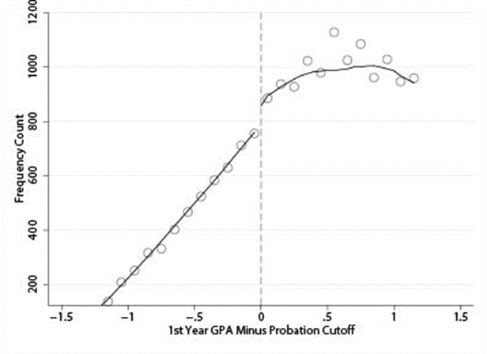

Slide 17
Measures
Outcome variables
Leaving after first year
Changes in GPA of subsequent semesters
Graduation in 4, 5, and 6 years
Independent variables
GPA distance from cutoff, discrete at the hundredth
Interactions on either side of cut, dummy interactions with distance
Covariates
Female/male
English native language/non
High school grades above/below median
Campus attending

Slide 18

Equations
$Y_{ic}=m\left({GPANORM}_{ic}^{year1}\right)+ δ1\left({GPANORM}_{ic}^{year1}<0\right)+u_{ic}$

Slide 19
Preliminary results
Leave after first evaluation
 | (1) | (2) | (3) | (4) | (5) | (6) | (7)
VARIABLES | all | lowHS | highHS | male | female | english | noenglish
Gpa<cutoff | 0.013 | 0.017 | 0.007 | 0.029 | 0.003 | 0.020~ | 0.001
 | (0.008) | (0.011) | (0.014) | (0.018) | (0.012) | (0.011) | (0.014)
gpaXgpalscutoff | -0.039~ | -0.028 | -0.065~ | -0.024 | -0.048 | -0.023 | -0.076
 | (0.023) | (0.030) | (0.038) | (0.044) | (0.034) | (0.025) | (0.050)
gpaXgpagrcutoff | -0.016 | -0.016 | -0.019 | -0.013 | -0.018 | -0.021 | -0.002
 | (0.013) | (0.016) | (0.022) | (0.021) | (0.017) | (0.017) | (0.019)
Constant | 0.045*** | 0.042*** | 0.051*** | 0.041*** | 0.048*** | 0.051*** | 0.030***
 | (0.005) | (0.006) | (0.008) | (0.007) | (0.007) | (0.006) | (0.007)
Observations | 9,473 | 5,618 | 3,855 | 3,673 | 5,800 | 6,923 | 2,550
R-squared | 0.004 | 0.005 | 0.005 | 0.008 | 0.003 | 0.005 | 0.005

Slide 20
Results
Next session GPA
 | (1) | (2) | (3) | (4) | (5) | (6) | (7)
VARIABLES | all | lowHS | highHS | male | female | english | noenglish
Gpa<cutoff | 0.247*** | 0.219*** | 0.292*** | 0.229*** | 0.255*** | 0.243*** | 0.251***
 | (0.029) | (0.036) | (0.054) | (0.053) | (0.039) | (0.033) | (0.069)
gpaXgpalscutoff | 0.765*** | 0.674*** | 0.876*** | 0.906*** | 0.659*** | 0.783*** | 0.719***
 | (0.067) | (0.078) | (0.139) | (0.130) | (0.082) | (0.078) | (0.147)
gpaXgpagrcutoff | 0.699*** | 0.688*** | 0.679*** | 0.636*** | 0.739*** | 0.725*** | 0.626***
 | (0.055) | (0.070) | (0.093) | (0.093) | (0.076) | (0.057) | (0.122)
Constant | 0.275*** | 0.233*** | 0.339*** | 0.250*** | 0.290*** | 0.271*** | 0.287***
 | (0.020) | (0.025) | (0.037) | (0.032) | (0.030) | (0.021) | (0.044)
Observations | 8,457 | 5,014 | 3,443 | 3,251 | 5,206 | 6,124 | 2,333
R-squared | 0.035 | 0.034 | 0.032 | 0.041 | 0.033 | 0.040 | 0.025

Slide 21
Results
Graduation in six years
 | (1) | (2) | (3) | (4) | (5) | (6) | (7)
VARIABLES | all | lowHS | highHS | male | female | english | noenglish
Gpa<cutoff | 0.007 | 0.001 | 0.015 | -0.026 | 0.022 | -0.013 | 0.046
 | (0.028) | (0.033) | (0.039) | (0.048) | (0.036) | (0.033) | (0.054)
gpaXgpalscutoff | 0.505*** | 0.496*** | 0.455*** | 0.595*** | 0.409*** | 0.464*** | 0.603***
 | (0.058) | (0.071) | (0.094) | (0.103) | (0.092) | (0.072) | (0.139)
gpaXgpagrcutoff | 0.211*** | 0.239*** | 0.169* | 0.158~ | 0.247*** | 0.234*** | 0.142
 | (0.060) | (0.068) | (0.079) | (0.087) | (0.063) | (0.054) | (0.105)
Constant | 0.652*** | 0.625*** | 0.689*** | 0.621*** | 0.671*** | 0.640*** | 0.689***
 | (0.022) | (0.025) | (0.028) | (0.032) | (0.024) | (0.020) | (0.039)
Observations | 4,649 | 2,815 | 1,834 | 1,828 | 2,821 | 3,458 | 1,191
R-squared | 0.053 | 0.060 | 0.034 | 0.073 | 0.040 | 0.057 | 0.046

Slide 22
Threats to validity
Potential threats to internal validity
Discontinuity at the cutoff for all students or sub-subgroups if students or teachers tried to game the system
*** If for some reason low performing high school students know the cut off better than others
If students on academic probation did not read their letter
External validity
This study generalizes to students at comparable universities that fall within a similar bandwidth of from the cut

